Slide 1
A STUDY ON THE SUSTAINABILITY MANAGEMENT AND FINANCIAL PERFORMANCE OF INDIAN DESIGNS EXPORTS PVT LTD. Name : SANDHYA K SRN Number : R20MB156

Slide 2
OBJECTIVES OF THE STUDY:
To know schedule of change in the working capital.
To analyze the profitability and liquidity position of the company.
To analyze the financial strength and weakness of the company.
To analyze the financial growth of the company.
To analyze the fixed, current assets and current liabilities.
To study the growth perspective of Indian Design Private Limited.

Slide 3
SAMPLING
PRIMARY SOURCES
A primary source mainly includes the information given by various lecturer, staff members and also through the discussions and orientation classes given by the faculty of the organization. The information got through personal observation also include in this.
2. SECONDARY DATA
From the annual reports maintained by the organization/company such as Statement of the profit and loss Balance sheets
Books and journals pertaining to the topic.
Data are collected from the company website.

Slide 4
TOOLS FOR DATA COLLECTION
Common size statements
Comparative statements
Ratio analysis
Ratio analysis may be divided into four categories:
Profitability Ratio
Liquidity Ratios
Solvency Ratio
Activity Ratio

Slide 5
LIMITATIONS OF THE STUDY
The research was conducted over a period of five years, but it was not enough to examine every aspect of the work.
Since the research is based on historical data, it cannot be trusted.
When conducting a financial audit, companies often ignore price fluctuations. Companies do not provide an index for statistics when comparing data from different time periods. As a result, the company does not reflect the impact of inflation.
The results of the study will not be applied to other organizations and the results of the study will not be used to assess the future financial status of the organization.

Slide 6
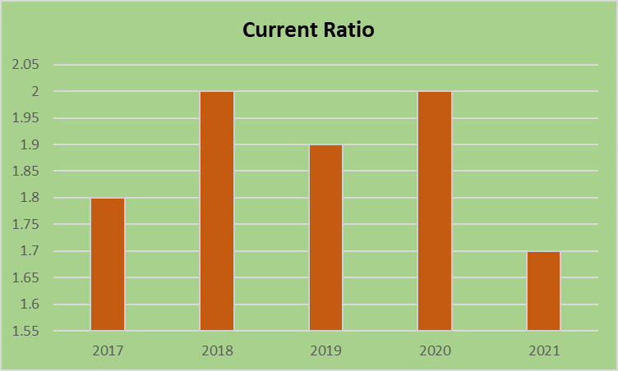
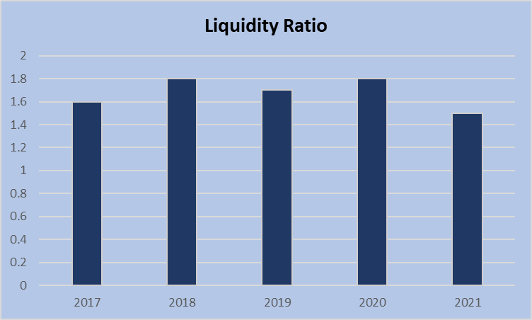
DATA ANALYSIS AND INTERPRETATION
According to the usual rule of current ratio 2:1, the performance of the current ratio in 2017 was 1.8 percent, and it increased to 2.0 percent in 2018, but declined to 1.7 percent in 2021.
The liquidity ratio 1:1. The above table that indicates the liquidity ratio of the company. In 2017 it was 1.6 and it has increased to 1.8 trends from 2018 to 2020. Then it decreased to 1.5 in the year 2021. A liquidity ratio 1:1 is considered to be satisfactory. The Liquidity Ratio of the firm is good

Slide 7
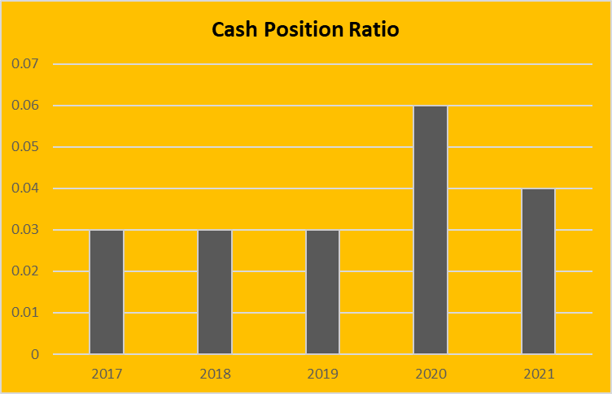
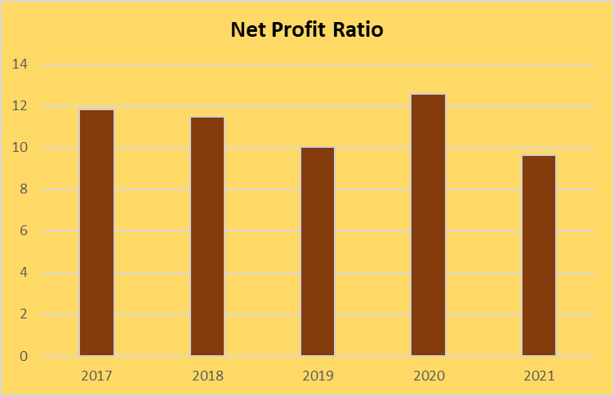
D
The Cash Position Ratio is the proportion of current assets to current liabilities. Between 0.2 and 0.5 is the optimum range in 2017 to 2019 remains constant it was 0.03 percentage and it has increased in 2020 with 0.06 percentage
It shows the efficiency of business as the net profit in 2017 it was 11.84 and it has fluctuating from 2018 to 2021. Then it decreases to 10.05 in the year 2019. So, this shows that the company has to increase the net profit has reducing the expenses. In the year 2021 there is a decrease in the ratio to 9.62.

Slide 8
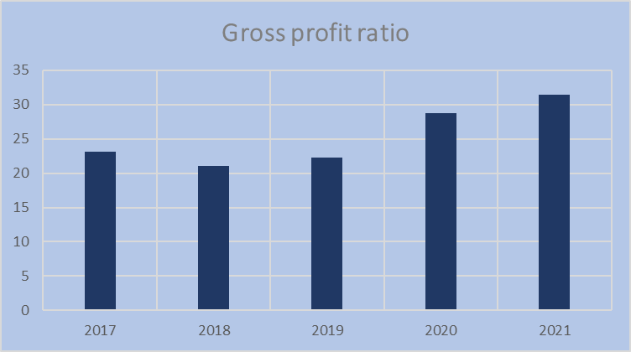
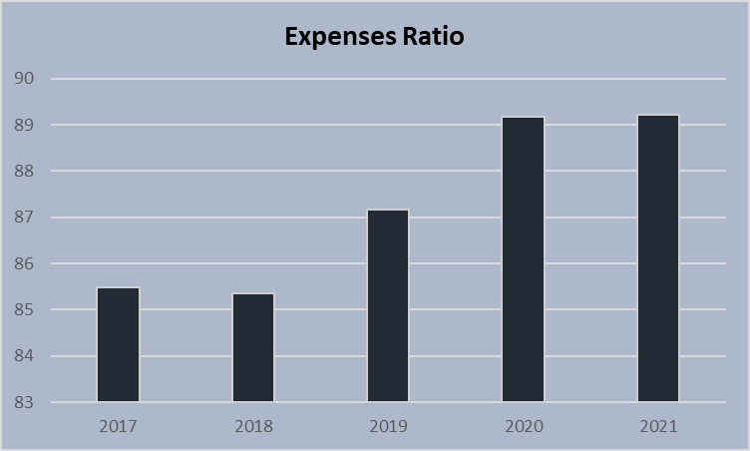
D
A bigger gross profit margin suggests that a business can profitably sell its products. The Gross Profit Ratio ranged from 23.08 to 31.39 over the study period 2017-2021.

Slide 9
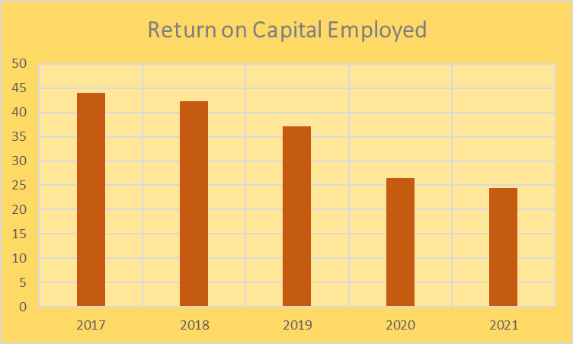
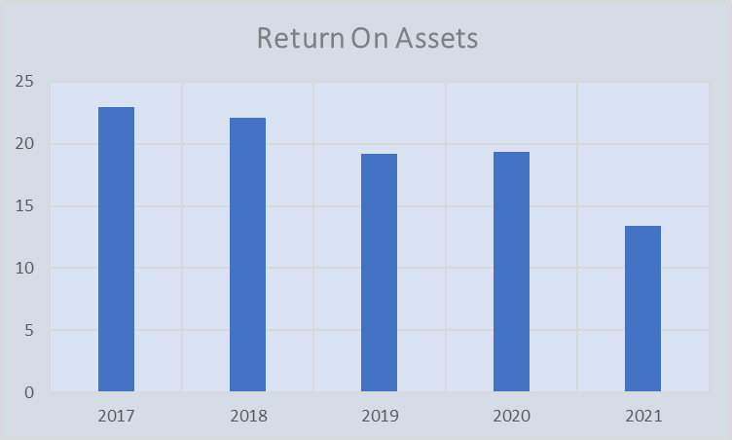
M
This demonstrates that the company's assets have not been put to work to create profits. The overall asset return In 2017, the rate of return on assets was 22.98 percent, with falling trends from 2018 to 2021.
The return on capital employed in 2017 it was 44 and it has decreasing in 2018 was 42.35. Then it decreasing trends from 2019 to 2021. It shows the return capital employed decreased.so company has to maintain the capital employed in future growth.

Slide 10
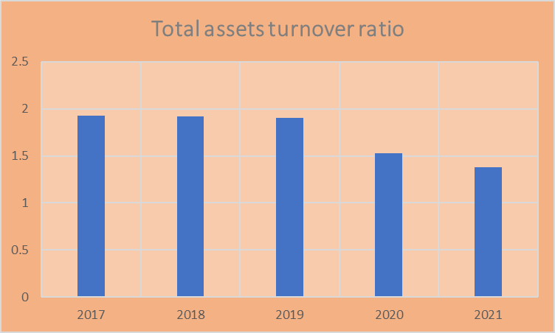
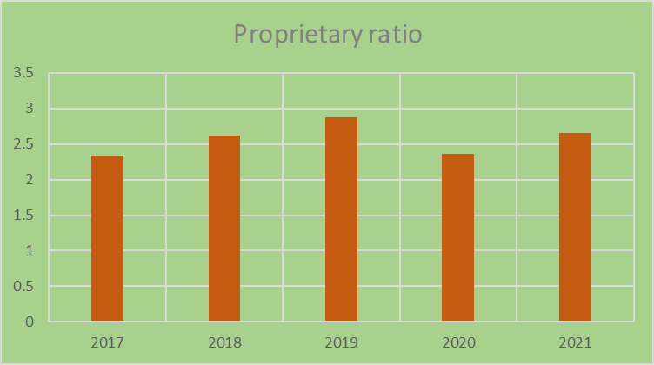
B
Low ratios indicate that the company is not utilizing its assets effectively and is more prone to maintenance or production problems. This ratio assesses how well a company utilizes its assets to create revenue, with a greater ratio always being preferable.
A higher ownership ratio, on the other hand, indicates a firm financial position and better security for creditors; The low ratio, on the other hand, indicates that the company’s operations are already significantly dependent on debt. The proprietary ratio depicts the contribution of shareholders to the company's total capital.

Slide 11
FINDINGS
Indian Design Pvt Gross Profitability Ratio (GPR). During the 2017-2021 research period, the gross profit ratio ranged from 23.08 to 31.39. A large gross profit margin indicates that the company can sell its products profitably.
Costs should be minimized rather than maximized; In 2017, it was 85.48 and it is projected to increase from 2019 to 2021. As a result, the company has to cut costs. There are a variety of cost ratios, including the gross cost ratio and the net cost ratio.
In 2017, the return on capital was 44, but in 2018 it dropped to 42.35. After that, from 2019 to 2021, it will be on a downward trend. Shows that the capital used for the return is reduced. As a result, the company must secure the money invested in future expansion.
In 2017, return on total assets was 22.98 per cent, with declining trends from 2018 to 2021. This indicates that the company assets have not been put into operation to generate revenue.

Slide 12
RECOMMENDATIONS
Indian Design Private Limited performance throughout the study period was strong during the first four years, and the company was efficient in maintaining financial capacity to support all of its development and diversification plans.
The firm should preserve liquid assets in order to strengthen its liquidity position in the future, as well as take the required actions to boost the company's earning capability.
They should boost the company's short-term liquidity, which will assist them satisfy their existing obligations.
The following were the recommendations made to the company:
The firm has implemented the appropriate plan to increase net profit in the next years.

Slide 13
CONCLUSION
The net profit margin has improved, indicating that the company can manage costs more efficiently. The company's current assets are sufficient to cover its current liabilities. Indian Designs Private Limited. Largest market share in the textile market. As planned revenues increased, the company was a profitable endeavor from a shareholder perspective. Compared to previous years, earnings per share have also increased. In general, the company has been successful in meeting the demands of shareholders and customers.
In terms of financial performance, a company's success is determined by how external financial markets view and respond to it. Financial managers need to understand how to make productive judgments while avoiding the useless ones.

Slide 14
THANK YOU

